Slide 1

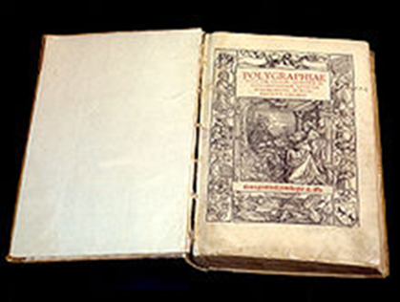
.avi Steganography & Steganalysis
Michael Dieterle
Gerry Reimer
Divine Puplampu
IT-S448 / ITMS 448/548
© 2014 Micheal, Gerry & Divine
Video File Steganography & and Steganalysis (AVI file format)
Slide <number>

Slide 2
Steganography v. Cryptography
  Advantages:
  Doesn’t attract attention
  Prevents possible incrimination
  Implications for social workers in countries with oppressive regimes, government researchers, proprietary business information, etc.
  Presents a fun new challenge for cryptographers and puzzle/riddle solvers
  Disadvantages:
    More complicated process
    May be harder for intended target to decipher
Cryptography only protects the contents of a message
Steganography conceals even that a secret message is being sent
IT-S448 / ITMS 448/548
© 2014 Micheal, Gerry & Divine
Video File Steganography & and Steganalysis (AVI file format)
Slide <number>

Slide 3
What is AVI
Audio Video Interleave
Contains both audio and video with synchronous playback ability
Large storage size
Can handle a variety of different compression types
“AVI has become the most popular container file format used for watching video on the PC” (“AVI”).³
IT-S448 / ITMS 448/548
© 2014 Micheal, Gerry & Divine
Video File Steganography & and Steganalysis (AVI file format)
Slide <number>

Slide 4
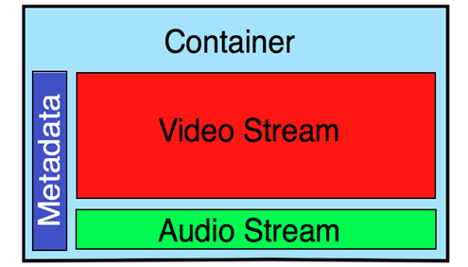
AVI FILE FORMAT
AVI is a container format meaning
  can contain video audio compressed using many different combinations of codecs
A codec (short for Compressor / Decompressors) tells the computer how to decode the audio and video tracks that have been encoded within the .AVI file
The bit rate is the number of bits per second required to make the video play. A bit is 0 or 1 - the smallest part of a digital file or signal
Video bit rates are measured in millions of bits per second - megabits (Mbps)
The Video Container (also called the wrapper) is the file format that encloses the header, video stream and audio stream.
Metadata can be the date the video was shot, resolution and even details on the video & audio codecs inside the file ¹⁰
Video Stream is the picture part of the video file and
contains a stream of a particular codec
Audio Stream is the audio part of the video file¹⁰
IT-S448 / ITMS 448/548
© 2014 Michael, Gerry & Divine
Video File Steganography & and Steganalysis (AVI file format)
Slide <number>

Slide 5
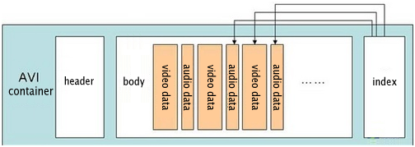
AVI
Headers contains metadata about video like width, height and frame rate
Indexes offset of data chunks in AVI file
AVI body can carry audio/visual data in virtually any compression scheme in it's chunks: MP4, uncompressed, cinepak, motion JPEG²
²
IT-S448 / ITMS 448/548
© 2014 Micheal, Gerry & Divine
Video File Steganography & and Steganalysis (AVI file format)
Slide <number>

Slide 6
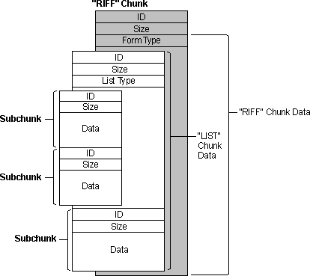
AVI with RIFF
AVI is a Derivative of RIFF (Resource Interchange File Format)²
  RIFF's divide data into “chunks”
AVI file takes up 1 chunk in a RIFF
⁹
IT-S448 / ITMS 448/548
© 2014 Micheal, Gerry & Divine
Video File Steganography & and Steganalysis (AVI file format)
Slide <number>

Slide 7
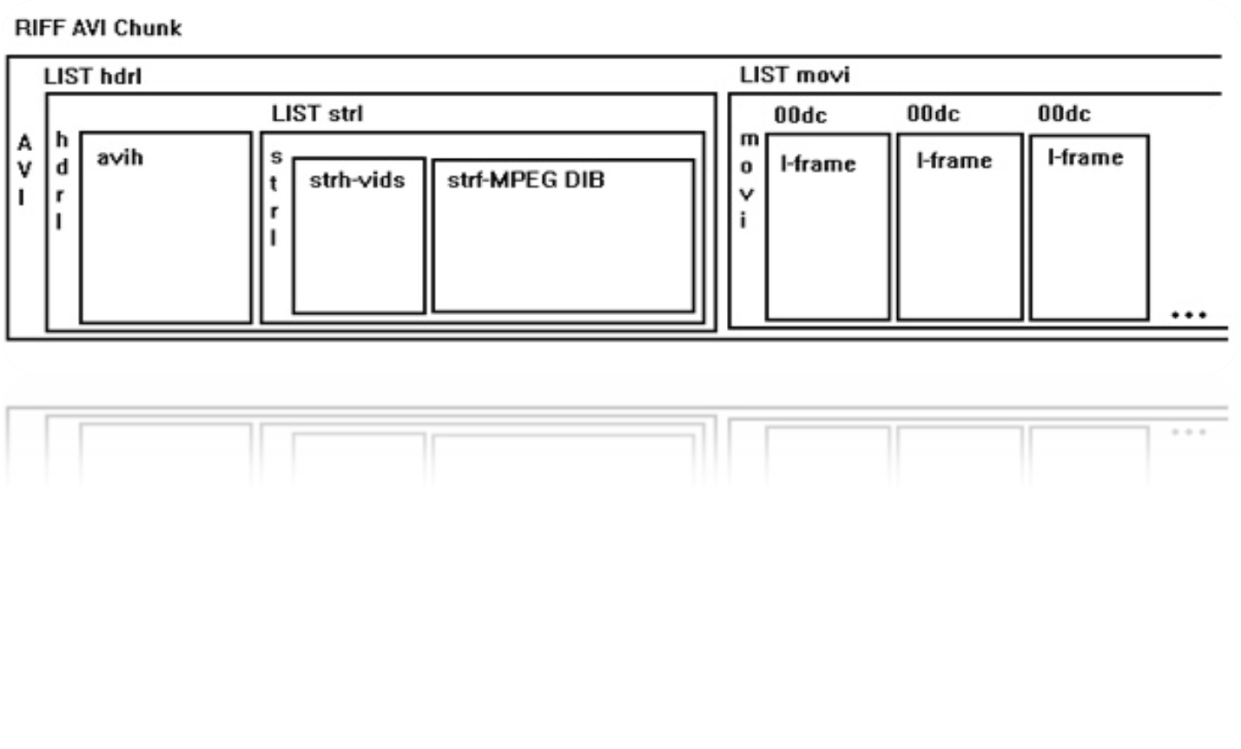
AVI within RIFF
That 1 AVI chunk is then divided into 2 mandatory “sub-chunks” & 1 optional “sub-chunk”
1st sub-chunk is the file header, IDed by “hdrl” tag, and contains metadata about the video like width, height, and frame rate
2nd sub-chunk contains the actual audio/visual data of the AVI movie and is IDed by “movi” tag. Where data is likely hidden
3rd sub-chunk (optional) indexes the offsets of the data chunks in the file and is IDed by “idx1” tag.⁵
⁷
IT-S448 / ITMS 448/548
© 2014 Micheal, Gerry & Divine
Video File Steganography & and Steganalysis (AVI file format)
Slide <number>

Slide 8
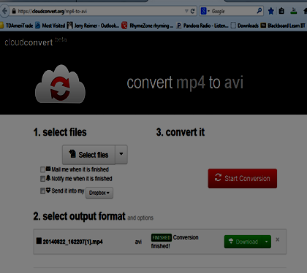
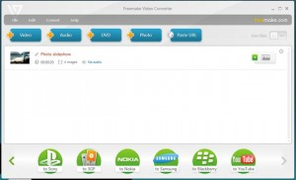
Convert From .mp4 to .avi
We use either of this tools depending on how big the file is ⁸
- FreeMake Video converter (if file > 100mB)
¹¹
IT-S448 / ITMS 448/548
© 2014 Micheal, Gerry & Divine
Video File Steganography & and Steganalysis (AVI file format)
Slide <number>

Slide 9
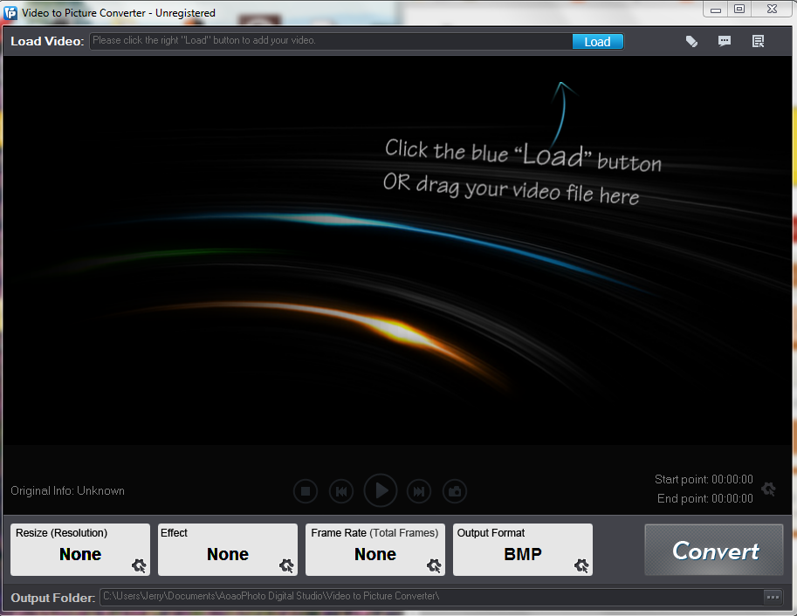
Convert .avi to .bmp
- Aoao Video to Picture Converter
- download here: http://www.aoaophoto.com/video-to-picture-converter/video-to-picture.htm
¹
IT-S448 / ITMS 448/548
© 2014 Micheal, Gerry & Divine
Video File Steganography & and Steganalysis (AVI file format)
Slide <number>

Slide 10
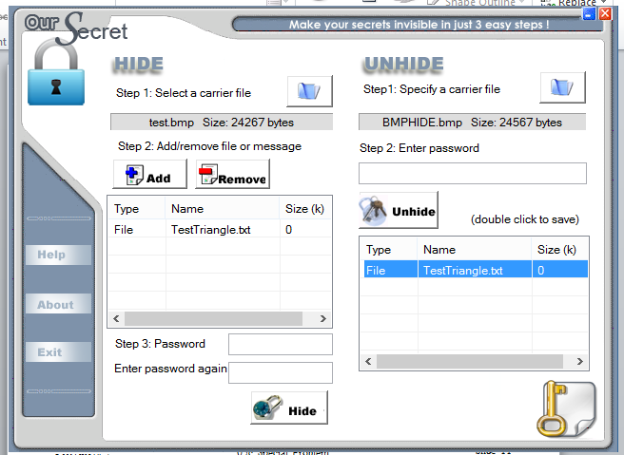
OurSecret
OurSecret is a steganography tool
OurSecret allows the use of .bmp files as container files
It may be used to insert hidden information within other files and the option to lock the information with a password
Very user friendly
⁶
IT-S448 / ITMS 448/548
© 2014 Micheal, Gerry & Divine
Video File Steganography & and Steganalysis (AVI file format)
Slide <number>

Slide 11
OurSecret
Takes advantage of unused bits of data
LSB (Least Significant Bit)
  Right most bit
Can hide data in file header and end of file too
Doesn’t add bits to data but modifies already existing bits
Uncompressed files are best to hide data in: .bmp & .wav¹²
IT-S448 / ITMS 448/548
© 2014 Micheal, Gerry & Divine
Video File Steganography & and Steganalysis (AVI file format)
Slide <number>

Slide 12
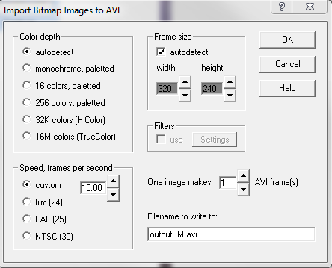
AVIEdit
Takes .bmp frames and recompiles them as .avi file
Video will run even after being broken into .bmp frames, having information hidden within it, and then being recompiled into a single .avi file⁴
IT-S448 / ITMS 448/548
© 2014 Micheal, Gerry & Divine
Video File Steganography & and Steganalysis (AVI file format)
Slide <number>

Slide 13
Semester Goals
Our project is a two semester project
First semester
  Our goal is to provide a proof of concept
Second semester
  Our goal is to make a comprehensive program
    The program will provide a GUI
Make our own toolkit if possible
IT-S448 / ITMS 448/548
© 2014 Micheal, Gerry & Divine
Video File Steganography & and Steganalysis (AVI file format)
Slide <number>

Slide 14
Works Cited
¹Aoao Video to Picture Converter. (n.d.). Retrieved December 1, 2014.
<http://www.aoaophoto.com/video-to-picture-converter/video-to-picture.htm>
²“AVI (Audio Video Interleaved) – Video Container and Format.” AVI (Audio
Video Interleaved) – Cideo Container and Format. (N.p., n.d). Web. 23 Sept, 2014.
³“AVI.”-DivX: Most PopulaR Video Format, DivX Codec Quality. (N.p., n.d).
Web. 23 Sept, 2014.
<http://www.divx.com/en/node/1001>.
⁴AVI editor by Alexander Milukov. (n.d.). Retrieved December 1, 2014.
<http://www.am-soft.ru/aviedit.html>
⁵Fleischman, E. “WAVE and AVI Coidec Registries.” Microsoft Corporation.
(N.p., June 1998). Web. 23 Sept, 2014.
<http://tools.ietf.org/html/rfc2361>.
⁶Free Tool, Our Secret - Hide secrets, Send serect video/audio/image, Share
information. (n.d.). Retrieved December 1, 2014.
<http://www.securekit.net/oursecret.htm>
IT-S448 / ITMS 448/548
© 2014 Michael, Gerry & Divine
Video File Steganography &and Steganalysis (AVI file format
Slide <number>
Notes:
EmbeddedSW.net

Slide 15
Works Cited
⁷MPEG Extension to AVI File Format "Editable MPEG File Format" Draft Version
1.1 of 5/13/94. (n.d.). Retrieved December 1, 2014, from
http://graphcomp.com/info/specs/ms/editmpeg.htm>
⁸Mp4 to avi - CloudConvert. (n.d.). Retrieved December 1, 2014, from
https://cloudconvert.com/mp4-to-avi>
⁹RIFF File Structure. (n.d.). Retrieved December 1, 2014, from http://www.johnloomis.org/cpe102/asgn/asgn1/riff.html>
¹⁰ShedWorx © Systemic Pty Ltd. (n.d.). Retrieved wed. 26 Nov. 2014. <http://www.shedworx.com/video-formats-uncovered>
¹¹Software of the Month: FREEMAKE | Total Computer Solutions. (n.d.).Retrieved December 1, 2014, from http://www.tcsusa.com/2014/07/22/software-month-freemake/
¹²Steganography software OurSecret hides text inside photos. (n.d.). Retrieved December 1, 2014, from http://www.hacker10.com/computer-security/steganography-software-oursecret-hides-text-inside-photos/
IT-S448 / ITMS 448/548
© 2014 Michael, Gerry & Divine
Video File Steganography &and Steganalysis (AVI file format
Slide <number>
Notes:
EmbeddedSW.net

